Slide 1
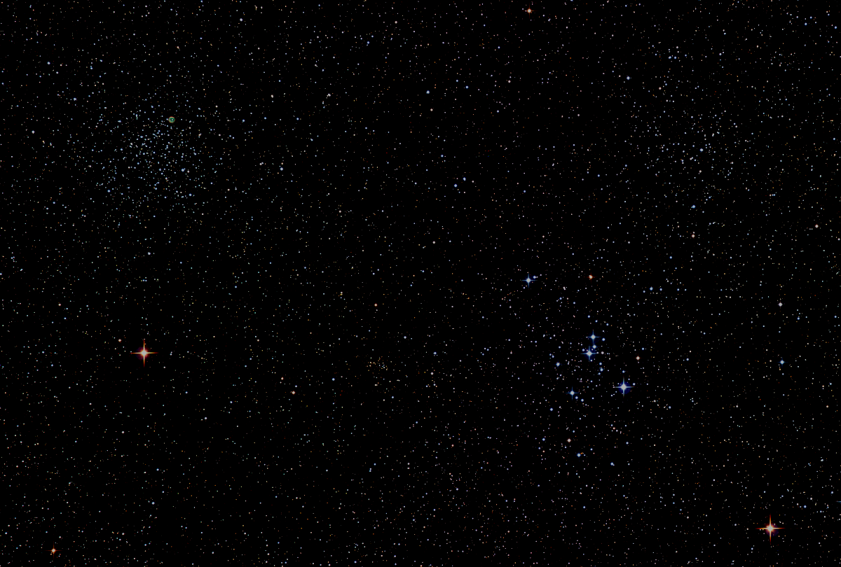

Howard
Astronomical
League
Year-end Wrap up
17
December 21, 2017
Notes:
Howard Astronomical League, Oct 19, 2017

Slide 2
Introductions
Self introductions during and after dinner

Slide 3
2018 HAL Elections
Election Committee Chair: Joel Goodman
Elections held at the January 18th general meeting to elect the 2018 Board of Directors
Send nominations to election@howardastro.org by 7pm on January 17th, 2018
New term begins Feb 1st, 2018

Slide 4
HAL Membership Stats
Memberships – 197
Members –262
Hal_Impromptu Members – 208
Howardastro Members – 394
Facebook Members - 345
2017 HAL Website Visitors – 100K +

Slide 5
Congratulations!
Dennis Conti’s coordination of the American Association of Variable Star Observers (AAVSO) amateur observations in support of a major Hubble Study of 15 exoplanets is mentioned on page 70 of the April 2017 edition of Sky and Telescope.

Slide 6
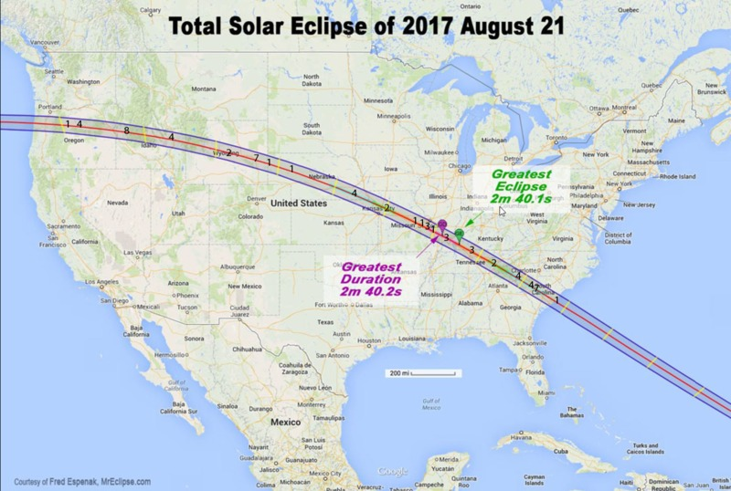

Slide 7
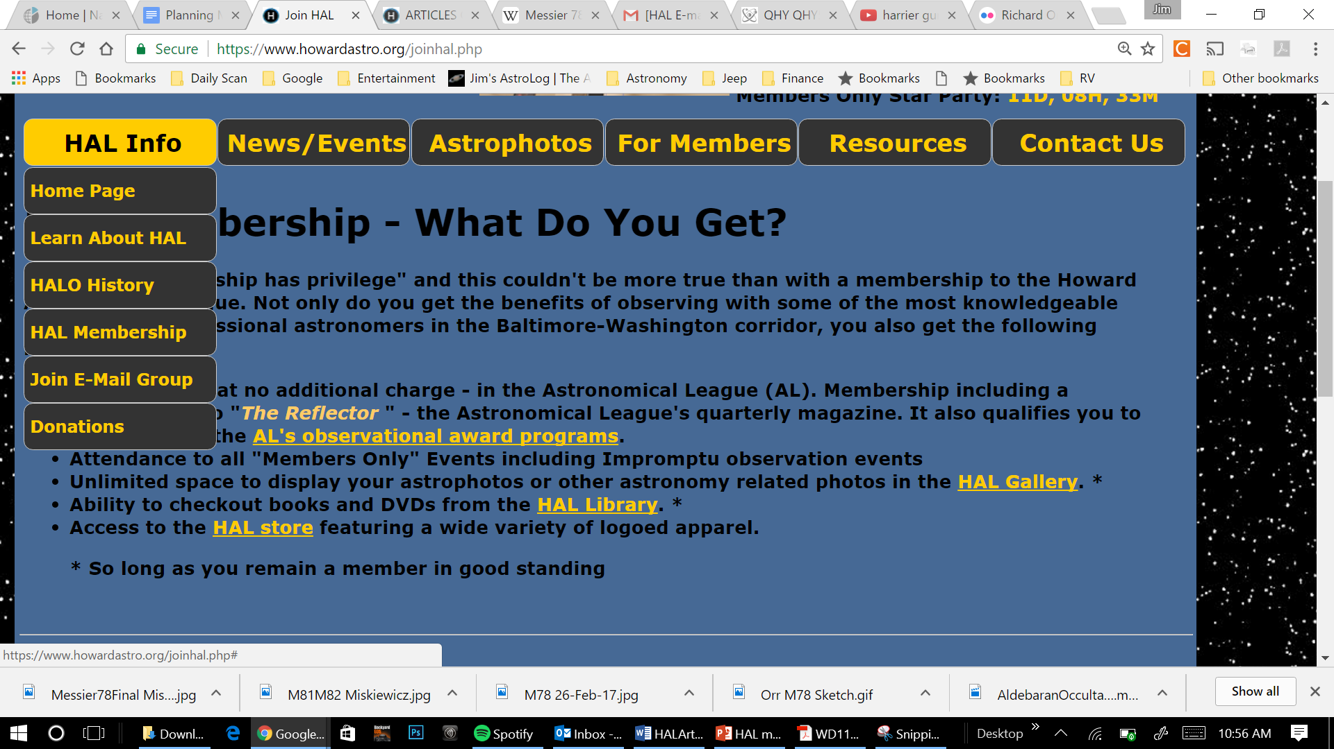
HAL Library Online
Working to increase size and availability next year!
Notes:
Ron Schwartz sent me the most recent Excel spreadsheet of the HAL Library contents yesterday. I have now replaced the previous library database contents with the new file. You can check it out on-line now via your HAL website log-in. In this version we are up to 175 books, CDs, or DVDs.
My next step, which may take a week or so, is to create an edit capability so that library staff members can add, modify, or delete library contents. This would include the capability to edit the fields that show that a book has been checked out, when, and by whom.
Once that is up and running we can discuss how a member interface with the database should work that will allow members to initiate the check-out process.

Slide 8
Observatory Chas Rimpo, Observatory Director
IT and Equipment Upgrades
New laptop
Improved USB and HDMI connectivity
Added planetary camera
Flyer box on door – future star party announcements
500-750 flyer pick up
Has lead to increased star party interest

Slide 9
Alpha Ridge Park Solar System Walk
Dedicated on May 6, 2017. John Bird, Director HoCo Rec and Parks presiding
An Eagle Scout project of Colin Brinster
Joel Goodman, Mentor

Slide 10
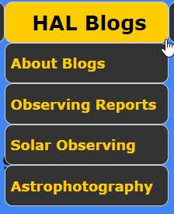
The HAL Board has established three new committees/blogs this year:
Bob Prokop
Phil Whitebloom
Ken Everhart

Slide 11
Member’s Astrophotos
and Sketches

Slide 12
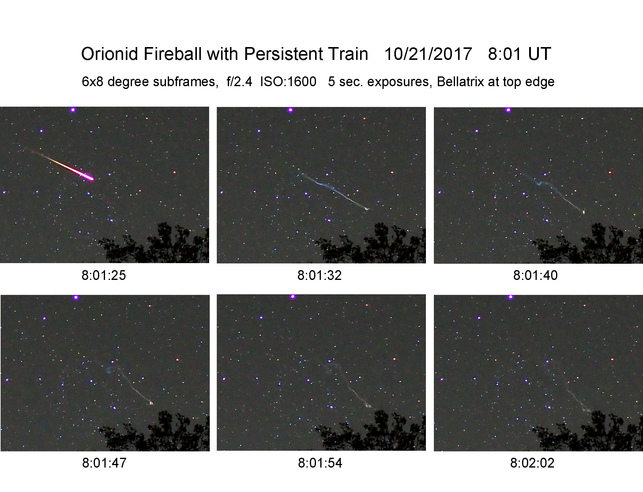
December
Gary Frishkorn

Slide 13
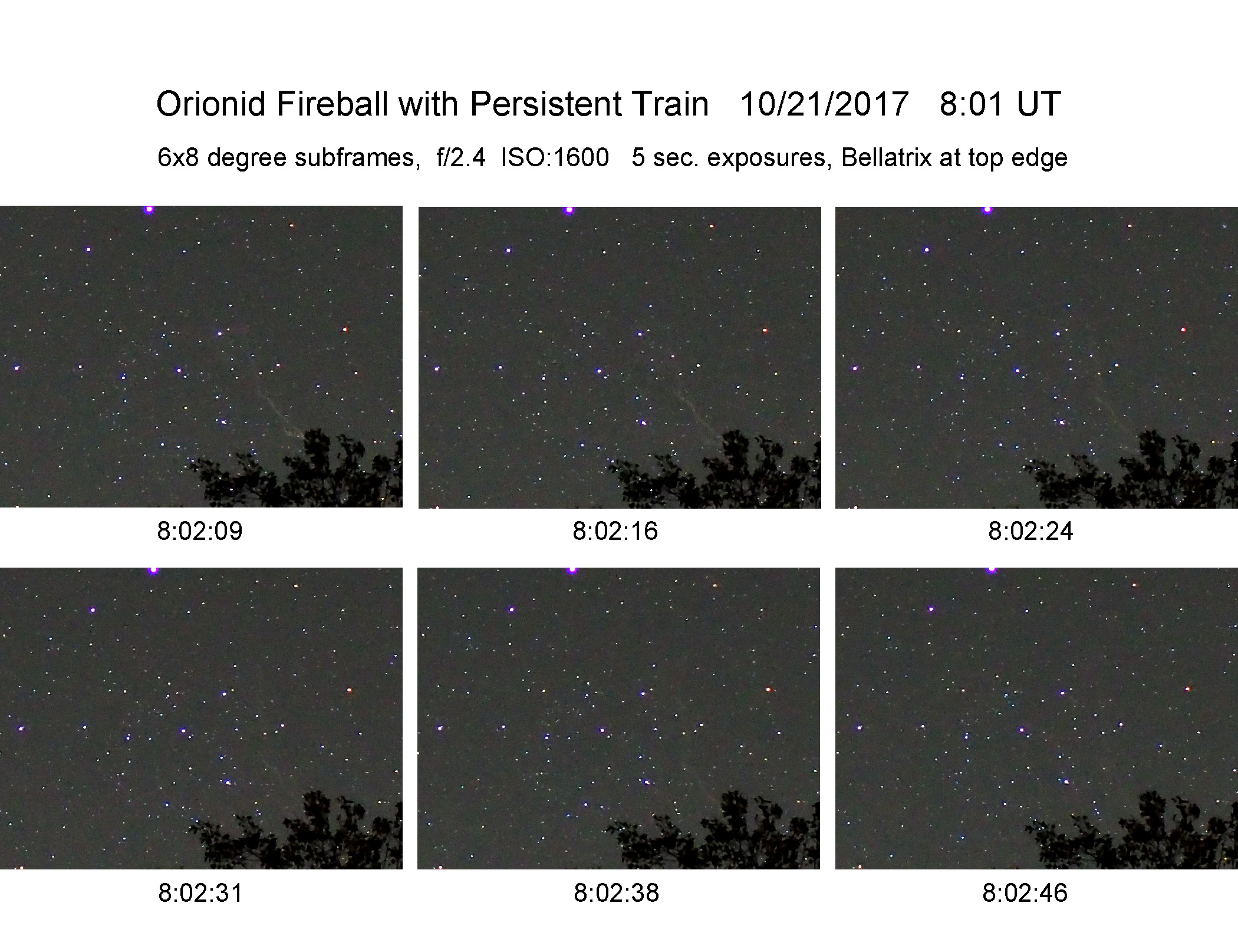

Slide 14
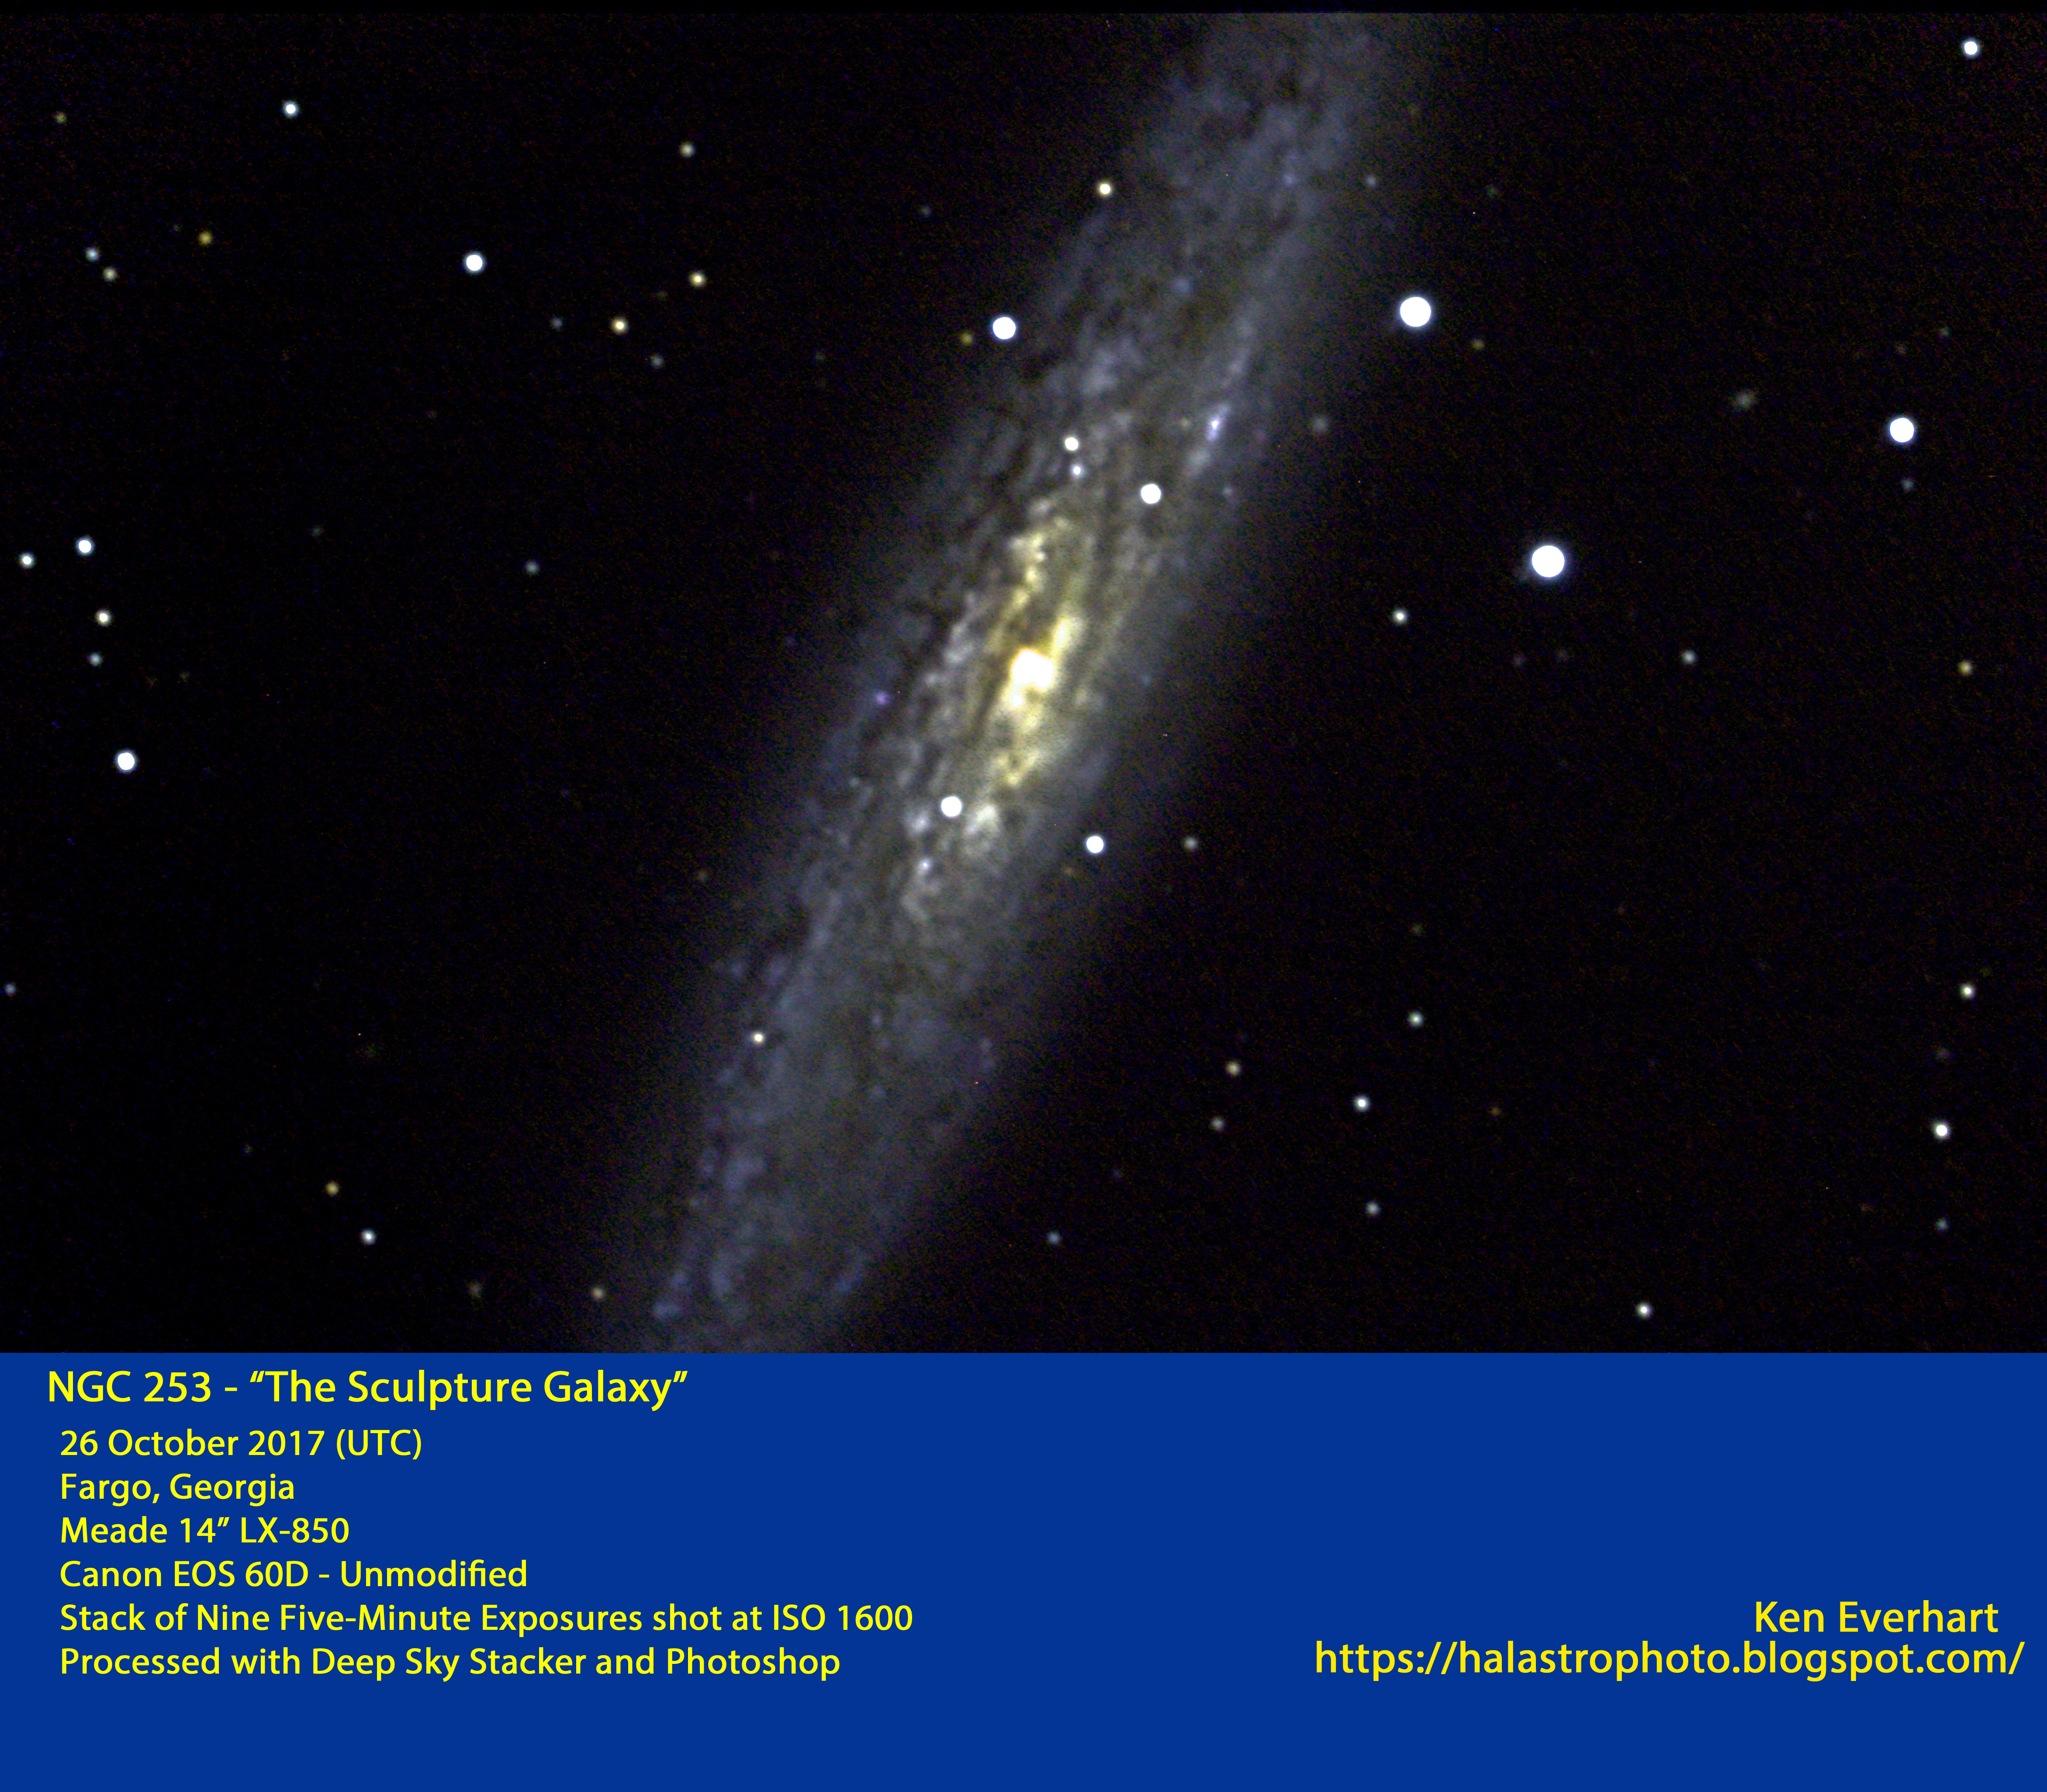

Slide 15
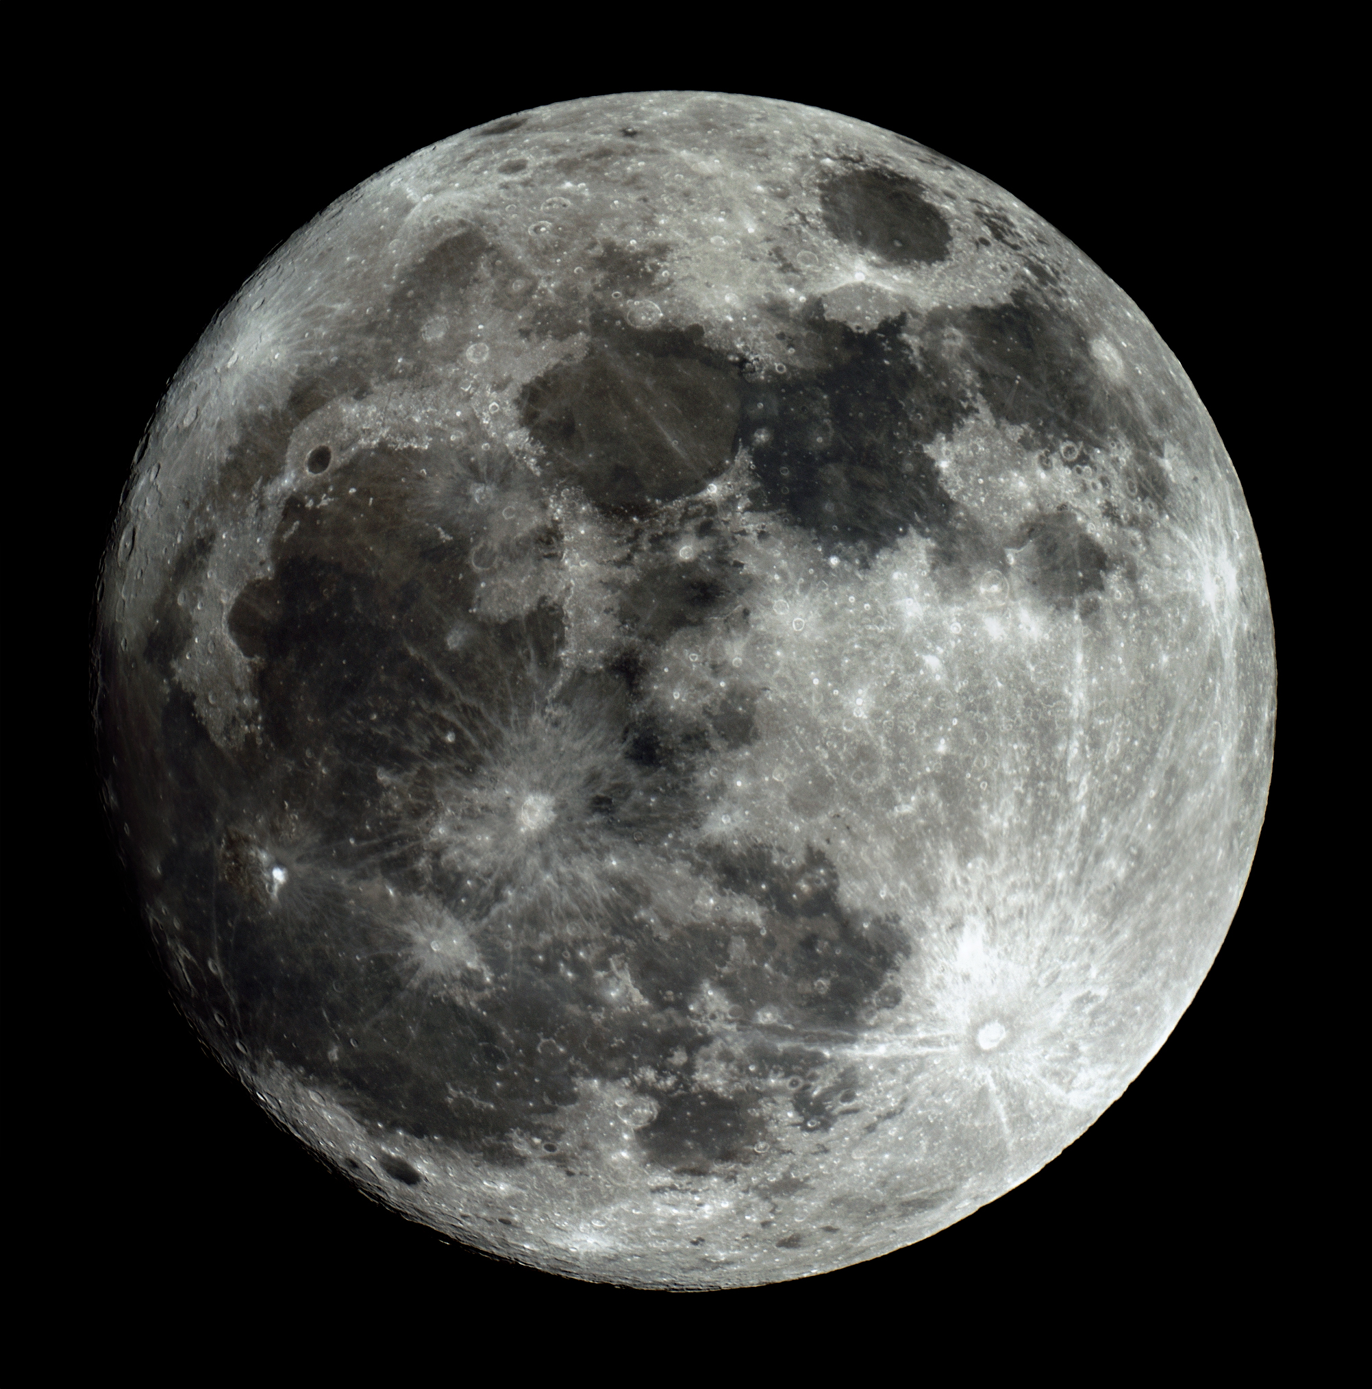
Matt Krutar
HAL Public Star Party
December 2nd, 2017

Slide 16
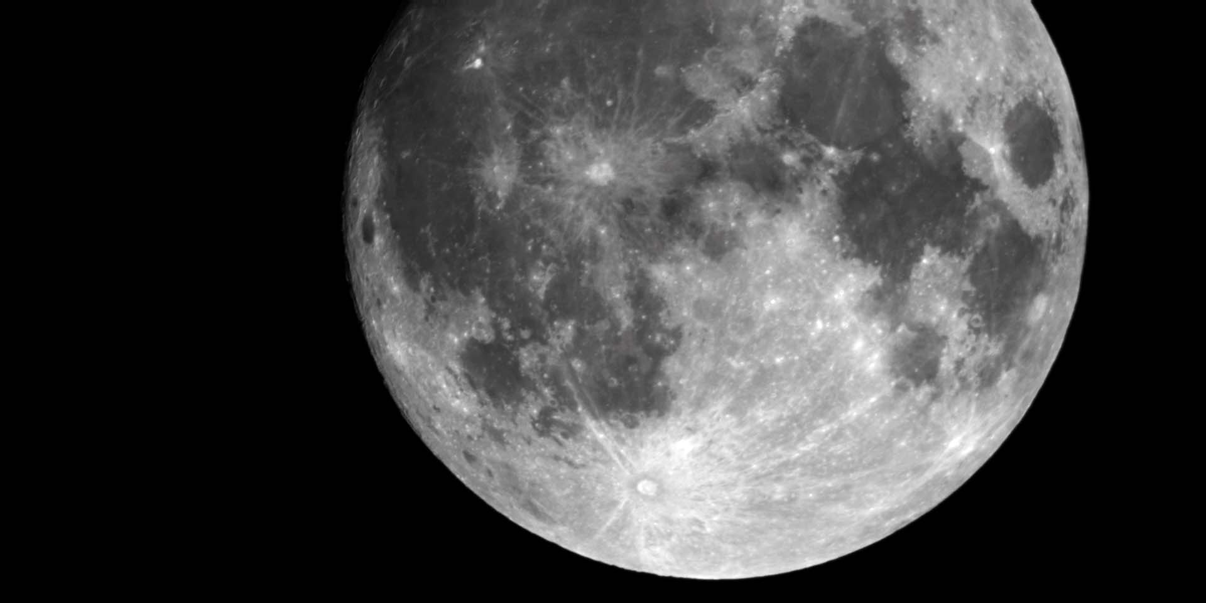
Super Moon
HAL Public Star Party, 02 Dec 2017
Watson Telescope, Mallincam Universe
David Stein and Jim Johnson

Slide 17
Thank You!
Next month’s meeting is on Thursday, January 18th, 2018 at 7 PM
Guest Speaker
Dr. Avi Mandell
Hot Jupiters and Lava Planets:
Exploring the Diversity of Exoplanet Environments

